Slide 1
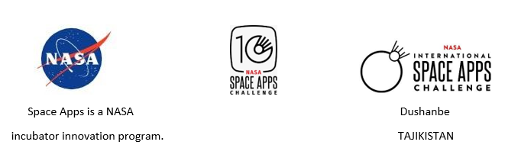
«Eclipse» Hackathon Project “THE SECRETS OF THE SUN”
Mahdi Samadov – Captain of the Eclipse team, aerospace engineer, PR manager.
Ilnar Khairullin – IT programmer, aerospace engineer.
Shohrukh Aminjanov – Web-developer.

Slide 2
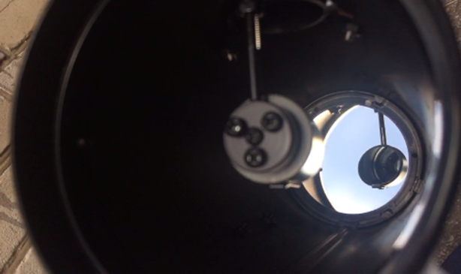
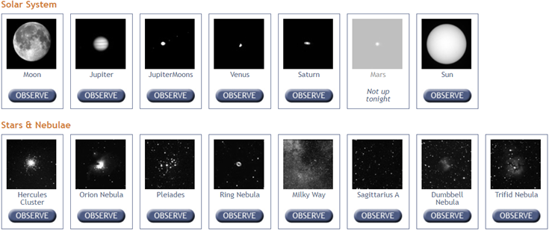
Astronomical observations of the Sun
The Observing with NASA website of the Harvard-Smithsonian Center for Astrophysics provides an opportunity to conduct free observations and photographing of spacecraft using a network of micro-observational robotic telescopes.

Slide 3
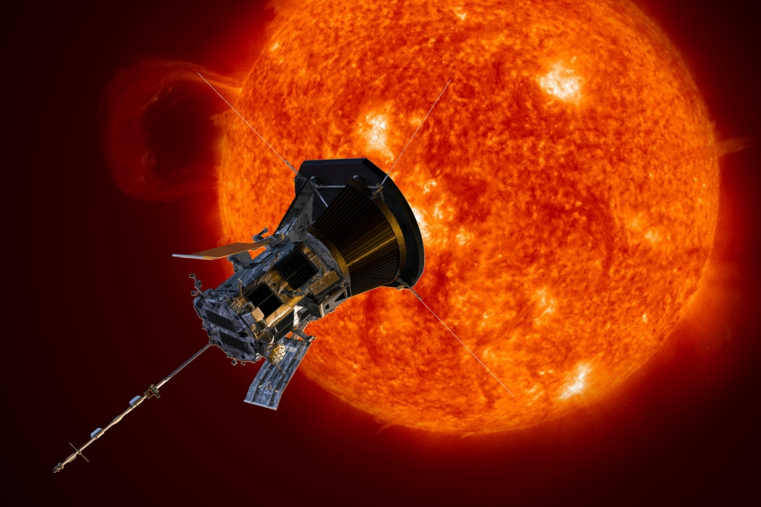
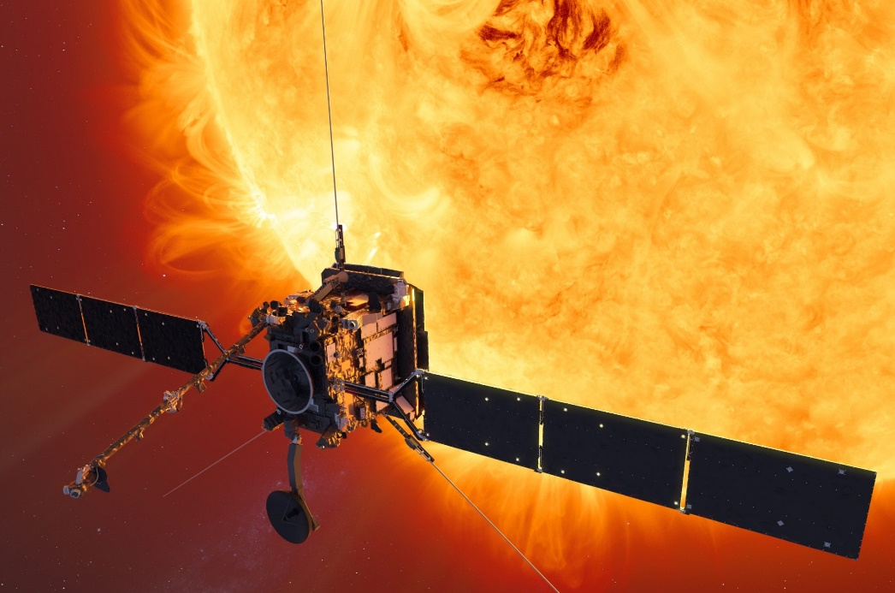
Improve public knowledge of the many spacecraft exploring the Sun
Parker Solar Probe and Solar Orbiter, which are designed to study the Sun closer than ever before, with a robust spacecraft fortified to conduct research in dangerous regions with an intense heat and solar radiation.
Parker Solar Probe
Solar Orbiter

Slide 4
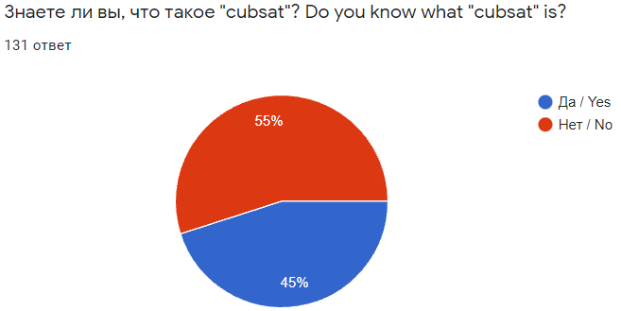
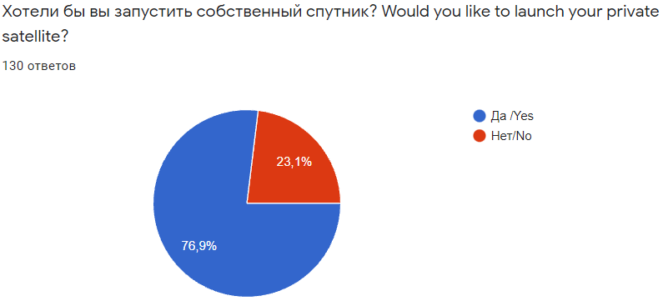
Attracting young people to the space industry
People who have completed a social survey through a Google form. Citizens of the following countries took part in the survey.
Tajikistan – 53; Russia -39; Brazil-3; Peru-2; USA-2; Nigeria -3; Burkina Faso -1; UK-1; Japan -1; Mexico -1; Bulgaria -1; Kazakhstan -4; India-3; Ethiopia -2; Iraq -1; Canada-1; Bangladesh-2; Indonesia -1; Uzbekistan -1; Palestine -1; Cameroon -1; Belarus -1; Egypt -1; DNR -1

Slide 5

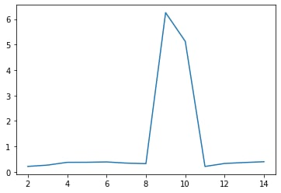
Automate the processing of the Solar images obtained from NASA and ESA
We’ve used Python with Tensorflow and Keras frameworks to learn CNN and calculate Wolf number. Code and DataSet will available on GitHub
W = k (f + 10g)
g-Sun spots groups
f-Sun spots count
k=const=1
Horizontal axis is testing images and vertical axis is relative error (%)

Slide 6
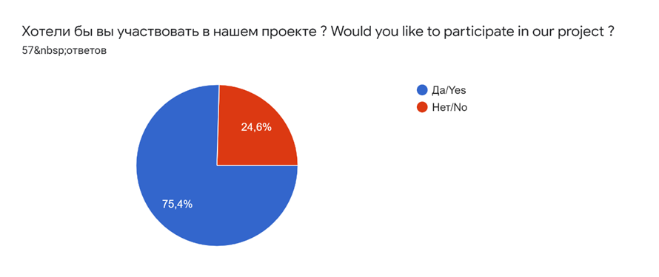
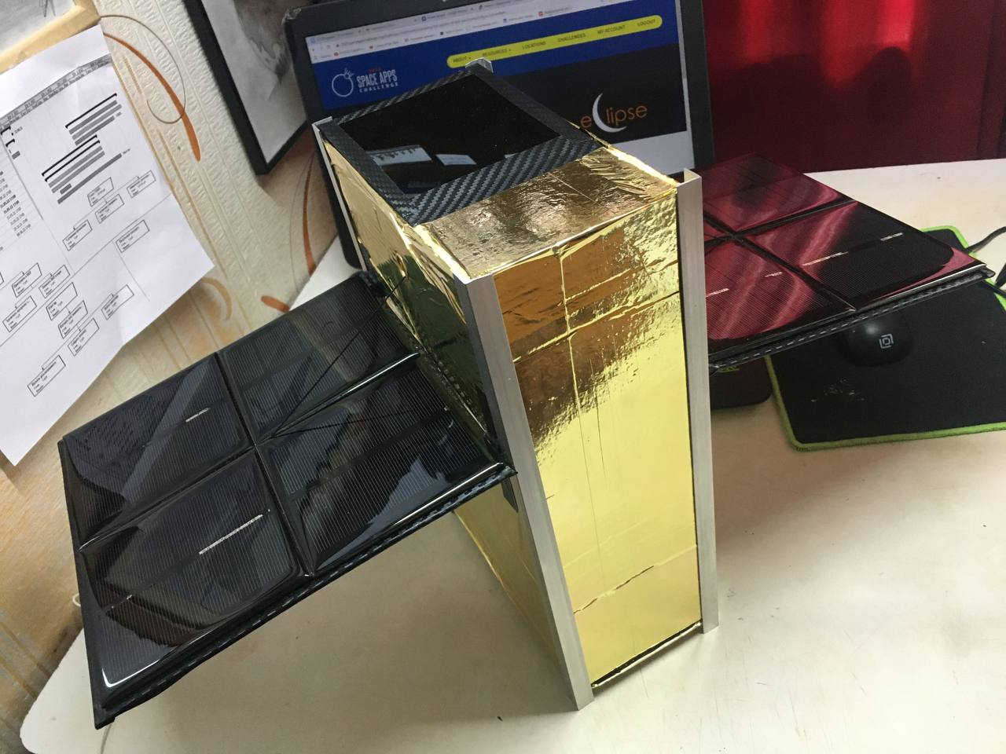
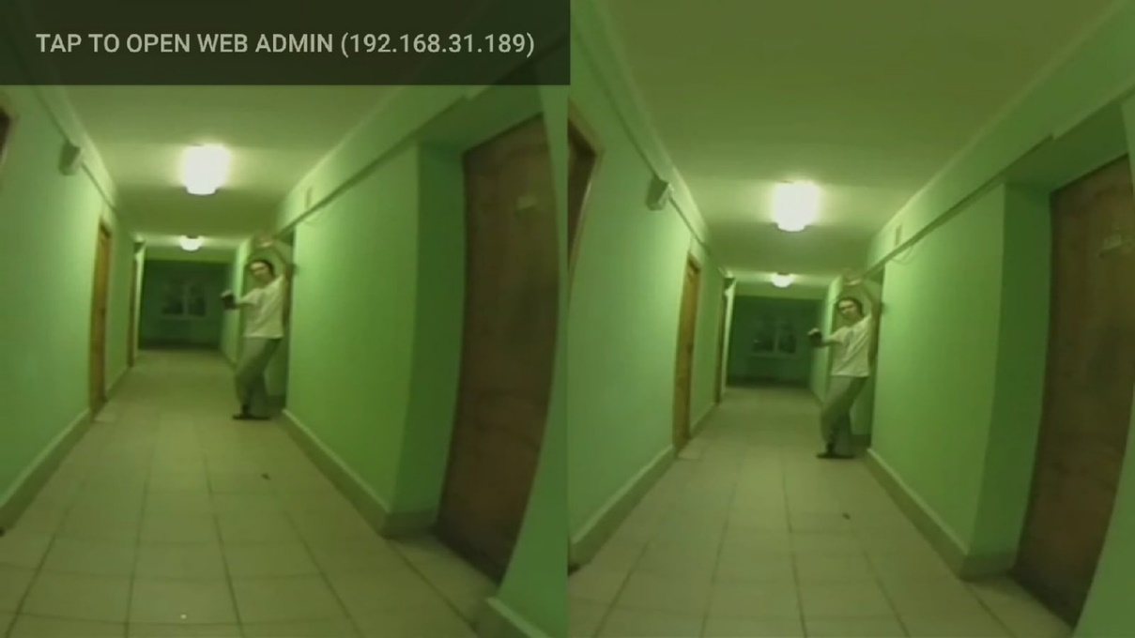
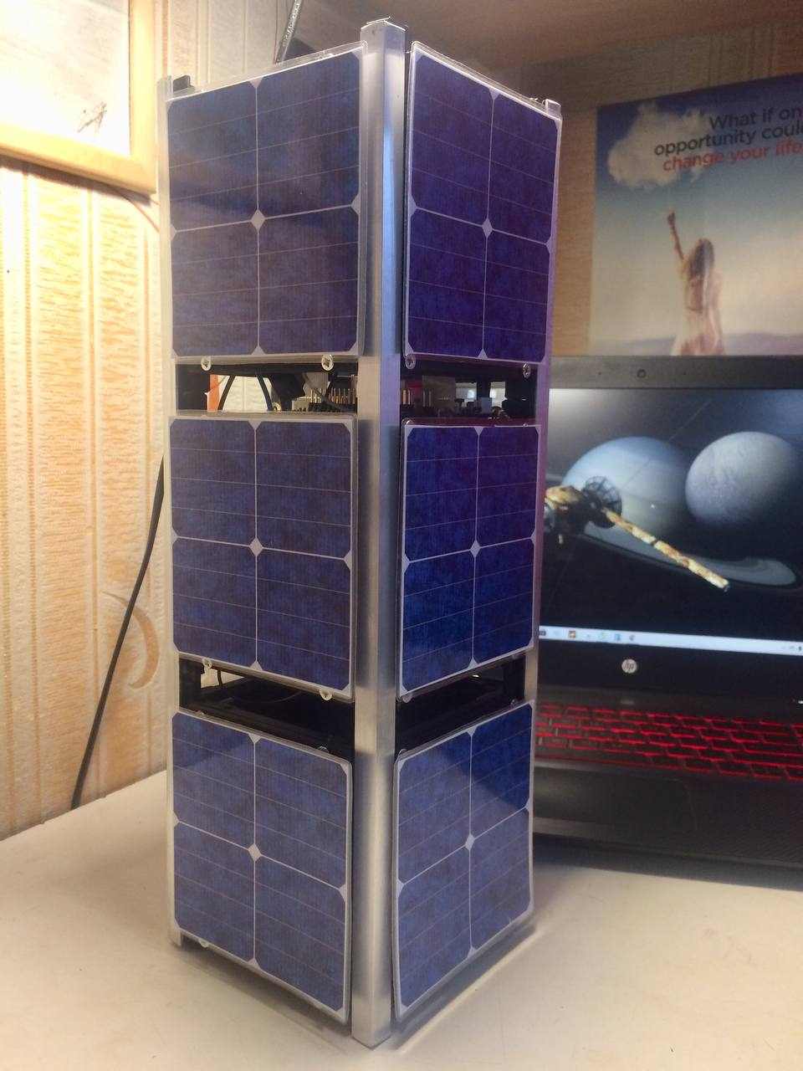

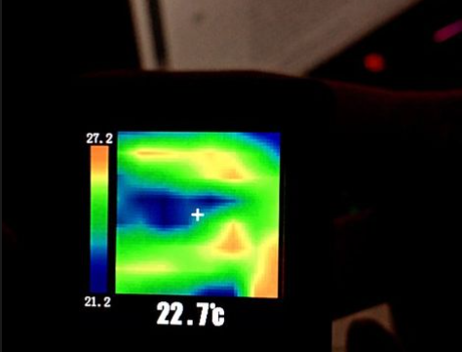
RESULTS OF ECLIPSE PROJECT
EclipseSat 6U
ToySat
Solar photo EclipseSat 6U

Slide 7

THANK YOU FOR YOUR ATTENTION
https://github.com/razbiralochka/Eclipse_Project.git

